Slide 1
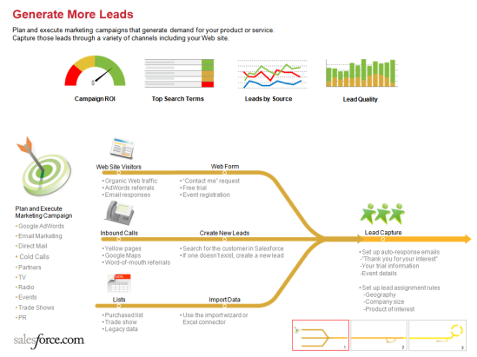
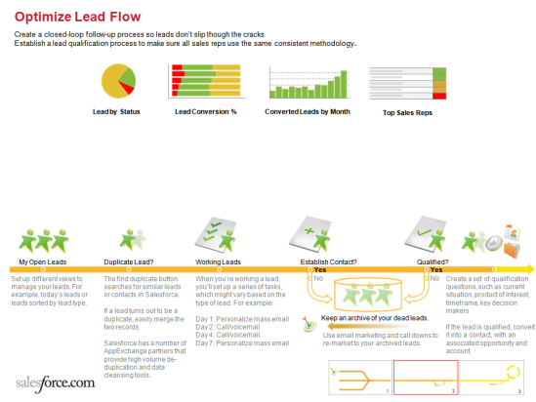
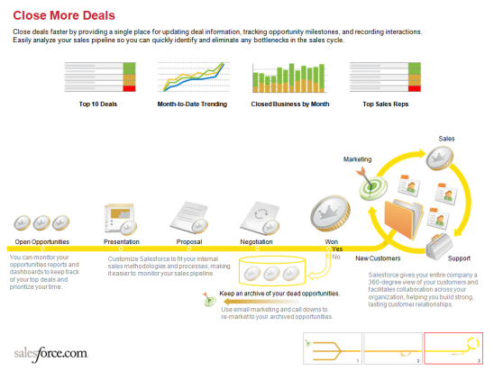
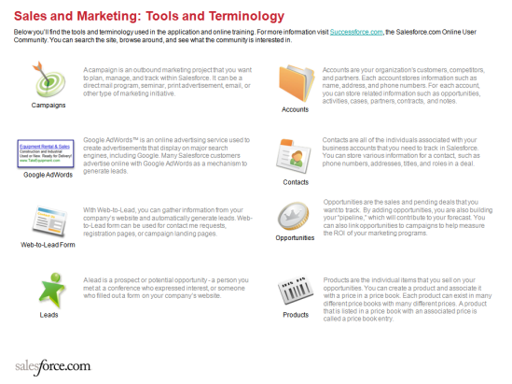
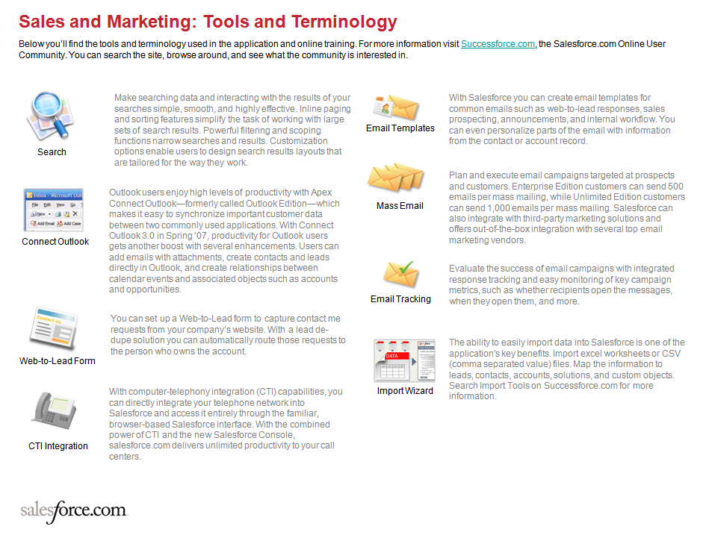
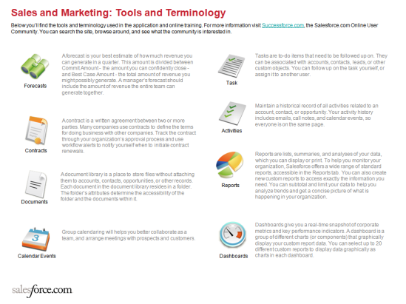
Sales and Marketing
Process Map – Winter ‘08

Slide 2


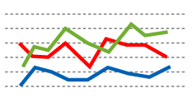










Generate More Leads
Plan and execute marketing campaigns that generate demand for your product or service.
Capture those leads through a variety of channels including your Web site.
Campaign ROI
Top Search Terms
Leads by Source
Lead Quality
Web Site Visitors
Web Form
• Organic Web traffic
• AdWords referrals
• Email responses
• “Contact me” request
• Free trial
• Event registration
Plan and Execute
Marketing Campaign
• Google AdWords
• Email Marketing
• Direct Mail
• Cold Calls
• Partners
• TV
• Radio
• Events
• Trade Shows
• PR
Inbound Calls
Create New Leads
Lead Capture
• Yellow pages
• Google Maps
• Word-of-mouth referrals
Search for the customer in Salesforce
If one doesn’t exist, create a new lead
• Set up auto-response emails
-”Thank you for your interest”
-Your trial information
-Event details
Set up lead assignment rules
-Geography
-Company size
-Product of interest
Lists
Import Data
• Purchased list
• Trade show
• Legacy data
• Use the import wizard or Excel connector

Slide 3














Optimize Lead Flow
Create a closed-loop follow-up process so leads don’t slip though the cracks.
Establish a lead qualification process to make sure all sales reps use the same consistent methodology.
Lead by Status
Lead Conversion %
Converted Leads by Month
Top Sales Reps
My Open Leads
Duplicate Lead?
Working Leads
Establish Contact?
Qualified?
Yes
Yes
Set up different views to manage your leads. For example, today’s leads or leads sorted by lead type.
The find duplicate button
searches for similar leads or contacts in Salesforce.
If a lead turns out to be a duplicate, easily merge the two records.
Salesforce has a number of AppExchange partners that provide high volume de-duplication and data cleansing tools.
When you’re working a lead, you’ll set up a series of tasks, which might vary based on the type of lead. For example:
Day 1: Personalize mass email
Day 2: Call/voicemail
Day 4: Call/voicemail
Day 7: Personalize mass email
No
No
Create a set of qualification questions, such as current situation, product of interest, timeframe, key decision makers
If the lead is qualified, convert it into a contact, with an associated opportunity and account.
Keep an archive of your dead leads.
Use email marketing and call downs to re-market to your archived leads.

Slide 4













Close More Deals
Close deals faster by providing a single place for updating deal information, tracking opportunity milestones, and recording interactions.
Easily analyze your sales pipeline so you can quickly identify and eliminate any bottlenecks in the sales cycle.
Top 10 Deals
Month-to-Date Trending
Closed Business by Month
Top Sales Reps
Sales
Marketing
Open Opportunities
Presentation
Proposal
Negotiation
Won
Yes
You can monitor your opportunities reports and dashboards to keep track of your top deals and prioritize your time.
Customize Salesforce to fit your internal sales methodologies and processes, making it easier to monitor your sales pipeline.
No
New Customers
Support
Salesforce gives your entire company a 360-degree view of your customers and facilitates collaboration across your organization, helping you build strong, lasting customer relationships.
Keep an archive of your dead opportunities.
Use email marketing and call downs to re-market to your archived opportunities.

Slide 5

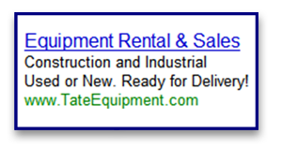



Sales and Marketing: Tools and Terminology
Below you’ll find the tools and terminology used in the application and online training. For more information visit Successforce.com, the Salesforce.com Online User Community. You can search the site, browse around, and see what the community is interested in.
A campaign is an outbound marketing project that you want to plan, manage, and track within Salesforce. It can be a direct mail program, seminar, print advertisement, email, or other type of marketing initiative.
Accounts are your organization's customers, competitors, and partners. Each account stores information such as name, address, and phone numbers. For each account, you can store related information such as opportunities, activities, cases, partners, contracts, and notes.
Campaigns
Accounts
Google AdWords™ is an online advertising service used to create advertisements that display on major search engines, including Google. Many Salesforce customers advertise online with Google AdWords as a mechanism to generate leads.
Contacts are all of the individuals associated with your business accounts that you need to track in Salesforce. You can store various information for a contact, such as phone numbers, addresses, titles, and roles in a deal.
Google AdWords
Contacts
Opportunities are the sales and pending deals that you want to track. By adding opportunities, you are also building your “pipeline,” which will contribute to your forecast. You can also link opportunities to campaigns to help measure the ROI of your marketing programs.
With Web-to-Lead, you can gather information from your company’s website and automatically generate leads. Web-to-Lead form can be used for contact me requests, registration pages, or campaign landing pages.
Web-to-Lead Form
Opportunities
A lead is a prospect or potential opportunity - a person you met at a conference who expressed interest, or someone who filled out a form on your company’s website.
Products are the individual items that you sell on your opportunities. You can create a product and associate it with a price in a price book. Each product can exist in many different price books with many different prices. A product that is listed in a price book with an associated price is called a price book entry.
Leads
Products
Notes:
If you are interested in renaming salesforce.com’s standard application terminology for your own company deployment, read the help documentation then log a case to have it enabled in your account.

Slide 6




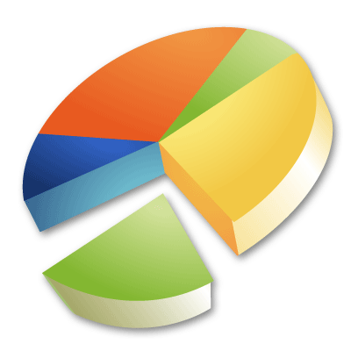



Sales and Marketing: Tools and Terminology
Below you’ll find the tools and terminology used in the application and online training. For more information visit Successforce.com, the Salesforce.com Online User Community. You can search the site, browse around, and see what the community is interested in.
A forecast is your best estimate of how much revenue you can generate in a quarter. This amount is divided between Commit Amount - the amount you can confidently close - and Best Case Amount - the total amount of revenue you might possibly generate. A manager’s forecast should include the amount of revenue the entire team can generate together.
Tasks are to-do items that need to be followed up on. They can be associated with accounts, contacts, leads, or other custom objects. You can follow up on the task yourself, or assign it to another user.
Forecasts
Task
Maintain a historical record of all activities related to an account, contact, or opportunity. Your activity history includes emails, call notes, and calendar events, so everyone is on the same page.
A contract is a written agreement between two or more parties. Many companies use contracts to define the terms for doing business with other companies. Track the contract through your organization’s approval process and use workflow alerts to notify yourself when to initiate contract renewals.
Activities
Contracts
Reports are lists, summaries, and analyses of your data, which you can display or print. To help you monitor your organization, Salesforce offers a wide range of standard reports, accessible in the Reports tab. You can also create new custom reports to access exactly the information you need. You can subtotal and limit your data to help you analyze trends and get a concise picture of what is happening in your organization.
A document library is a place to store files without attaching them to accounts, contacts, opportunities, or other records. Each document in the document library resides in a folder. The folder’s attributes determine the accessibility of the folder and the documents within it.
Reports
Documents
Dashboards give you a real-time snapshot of corporate metrics and key performance indicators. A dashboard is a group of different charts (or components) that graphically display your custom report data. You can select up to 20 different custom reports to display data graphically as charts in each dashboard.
Group calendaring will helps you better collaborate as a team, and arrange meetings with prospects and customers.
Calendar Events
Dashboards
Notes:
If you are interested in renaming salesforce.com’s standard application terminology for your own company deployment, read the help documentation then log a case to have it enabled in your account.

Slide 7


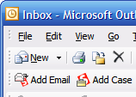
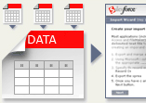

Sales and Marketing: Tools and Terminology
Below you’ll find the tools and terminology used in the application and online training. For more information visit Successforce.com, the Salesforce.com Online User Community. You can search the site, browse around, and see what the community is interested in.
Make searching data and interacting with the results of your searches simple, smooth, and highly effective. Inline paging and sorting features simplify the task of working with large sets of search results. Powerful filtering and scoping functions narrow searches and results. Customization options enable users to design search results layouts that are tailored for the way they work.
With Salesforce you can create email templates for common emails such as web-to-lead responses, sales prospecting, announcements, and internal workflow. You can even personalize parts of the email with information from the contact or account record.
Email Templates
Search
Plan and execute email campaigns targeted at prospects and customers. Enterprise Edition customers can send 500 emails per mass mailing, while Unlimited Edition customers can send 1,000 emails per mass mailing. Salesforce can also integrate with third-party marketing solutions and offers out-of-the-box integration with several top email marketing vendors.
Outlook users enjoy high levels of productivity with Apex Connect Outlook—formerly called Outlook Edition—which makes it easy to synchronize important customer data between two commonly used applications. With Connect Outlook 3.0 in Spring ’07, productivity for Outlook users gets another boost with several enhancements. Users can add emails with attachments, create contacts and leads directly in Outlook, and create relationships between calendar events and associated objects such as accounts and opportunities.
Mass Email
Connect Outlook
✓
Evaluate the success of email campaigns with integrated response tracking and easy monitoring of key campaign metrics, such as whether recipients open the messages, when they open them, and more.
Email Tracking
You can set up a Web-to-Lead form to capture contact me requests from your company’s website. With a lead de-dupe solution you can automatically route those requests to the person who owns the account.
The ability to easily import data into Salesforce is one of the application's key benefits. Import excel worksheets or CSV (comma separated value) files. Map the information to leads, contacts, accounts, solutions, and custom objects. Search Import Tools on Successforce.com for more information.
Web-to-Lead Form
With computer-telephony integration (CTI) capabilities, you can directly integrate your telephone network into Salesforce and access it entirely through the familiar, browser-based Salesforce interface. With the combined power of CTI and the new Salesforce Console, salesforce.com delivers unlimited productivity to your call centers.
Import Wizard
CTI Integration
Notes:
If you are interested in renaming salesforce.com’s standard application terminology for your own company deployment, read the help documentation then log a case to have it enabled in your account.

